Slide 1
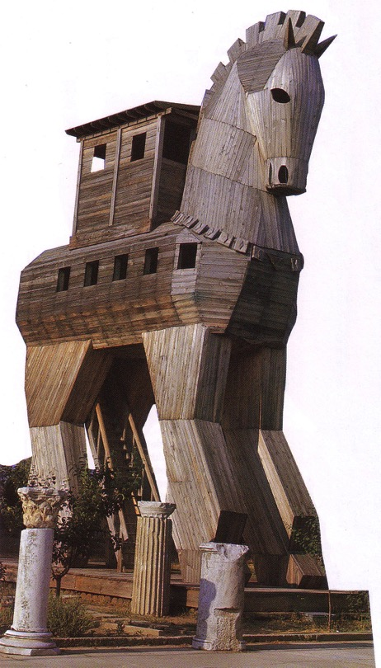
foaYmd,k miqìu fojk fldgi
8
Dr. Rick Griffith • Singapore Bible College • BibleStudyDownloads.org
Notes:
English on slides 4

Slide 2
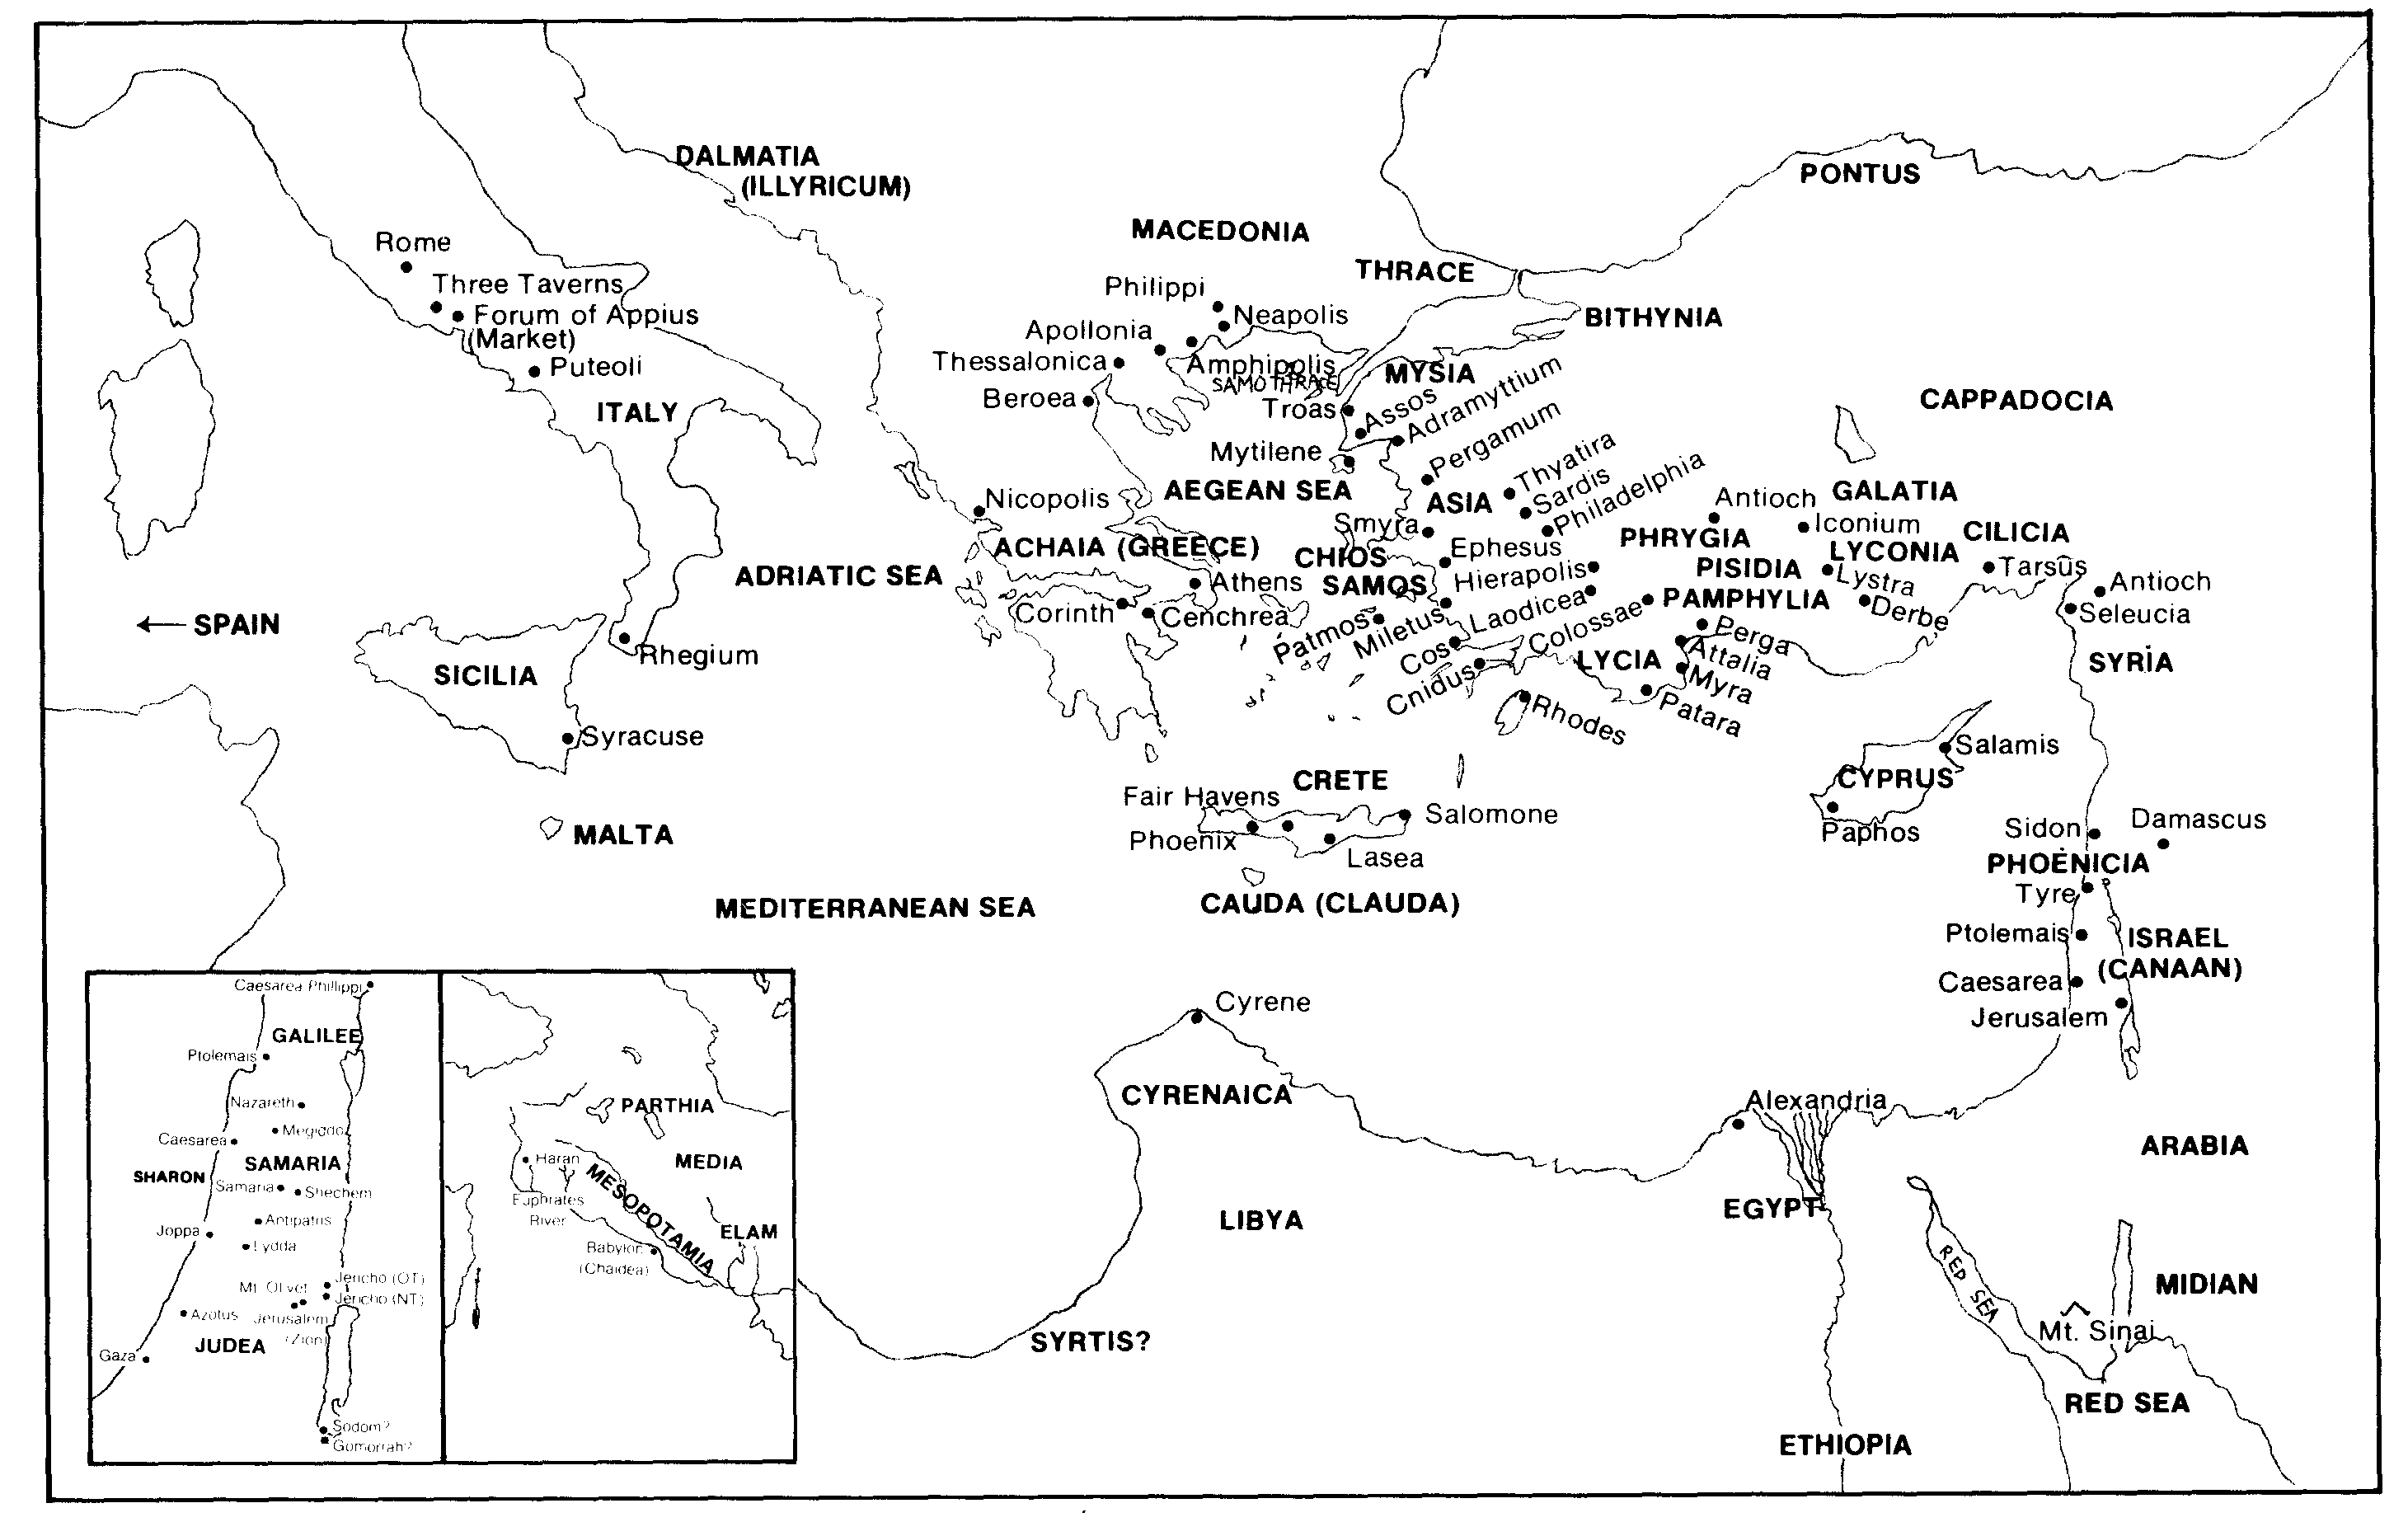
wfmdaia;=,qjrekaf.a l%shd fmd;g wkqj N+f.da,Sh miqìu
5

Slide 3
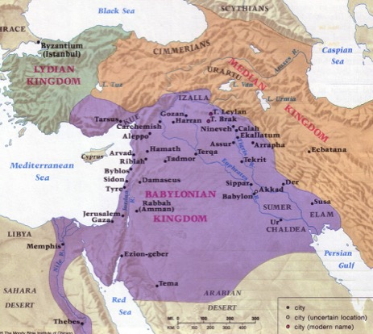
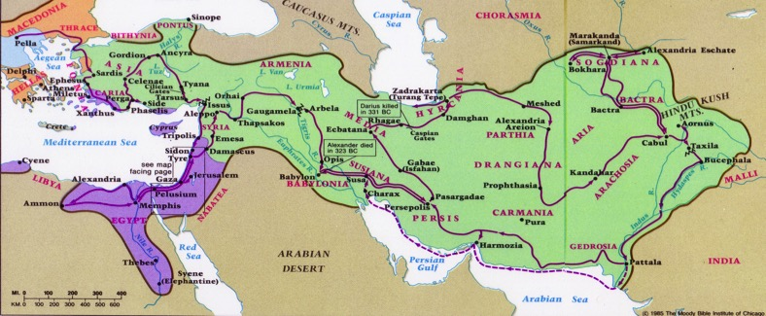
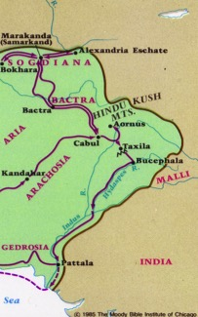
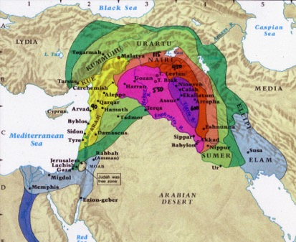
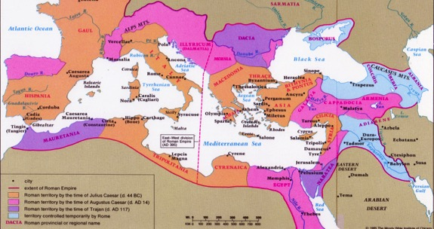
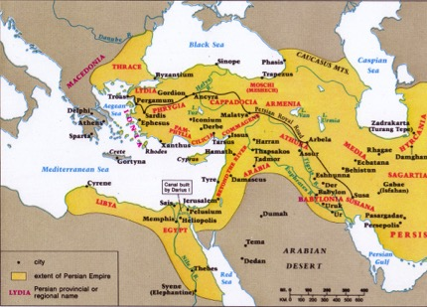
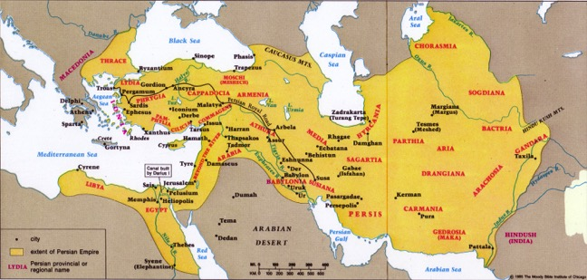
wêrdcHhka iy tajd wkqms<sfj,ska
52
.S%ish
nìf,daksh
wisrshdj
frdauh
m¾ishdj
Beitzel, 1st edition, 139-167

Slide 4
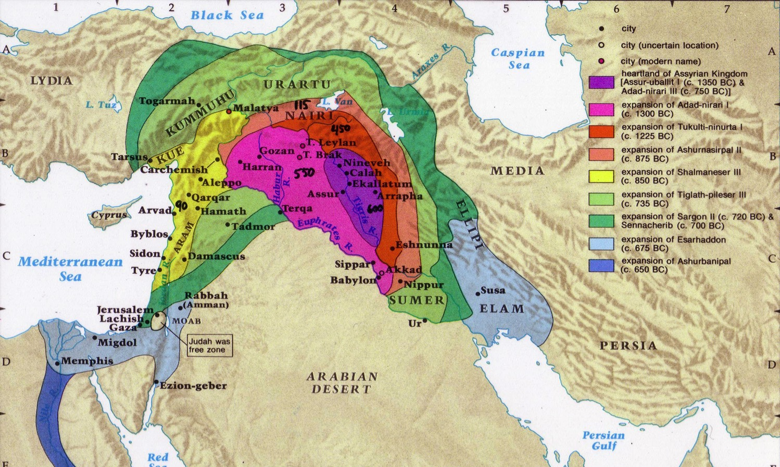
wisrshdfõ oshqKqj
48
iudrsfha jeàu
iudrs;hkaf.a msìoSu
Handwritten numbers show the number of years before Jonah in 760 BC
Beitzel, Moody Atlas of Bible Lands, 1st ed., 139

Slide 5
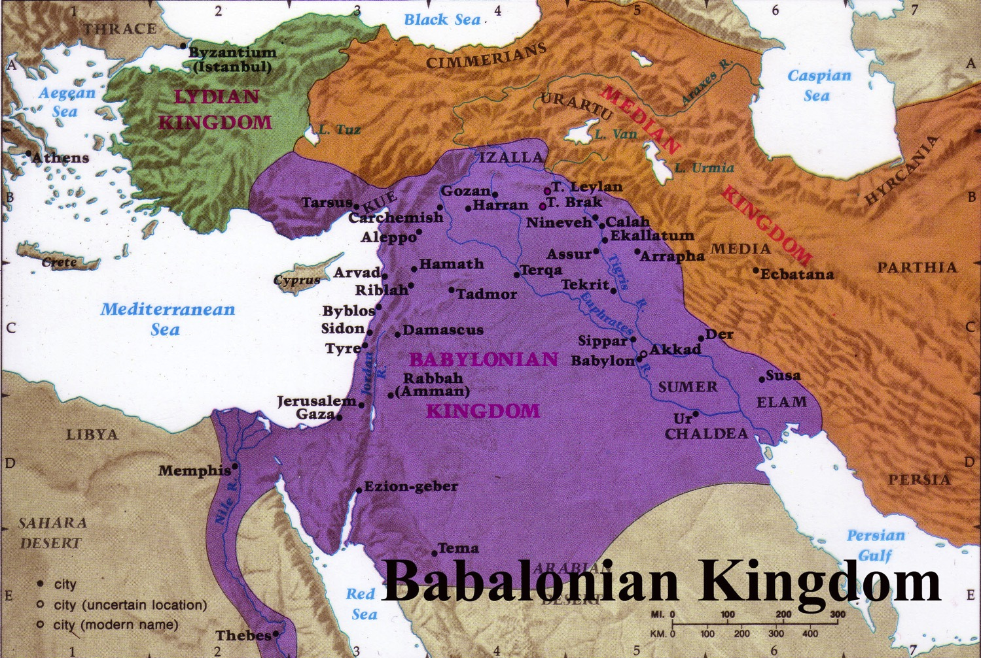
m,ia;Skfha nìf,dakshdkq md,kfha wjidkh
56
msgqjy,a lsrSu
j¾Okhka
fjka lsrSu
iskf.da.h
rEm jkaokdj ke;
Beitzel, Moody Atlas of Bible Lands, 1st ed., 145

Slide 6
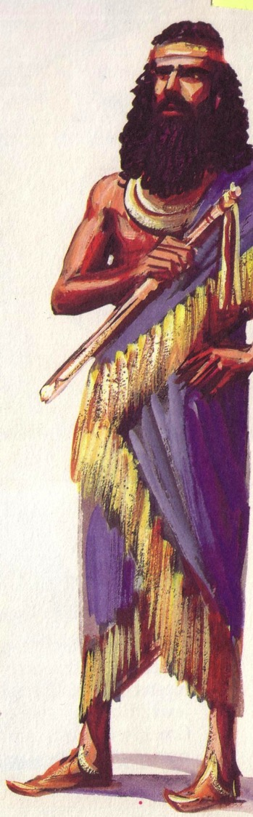

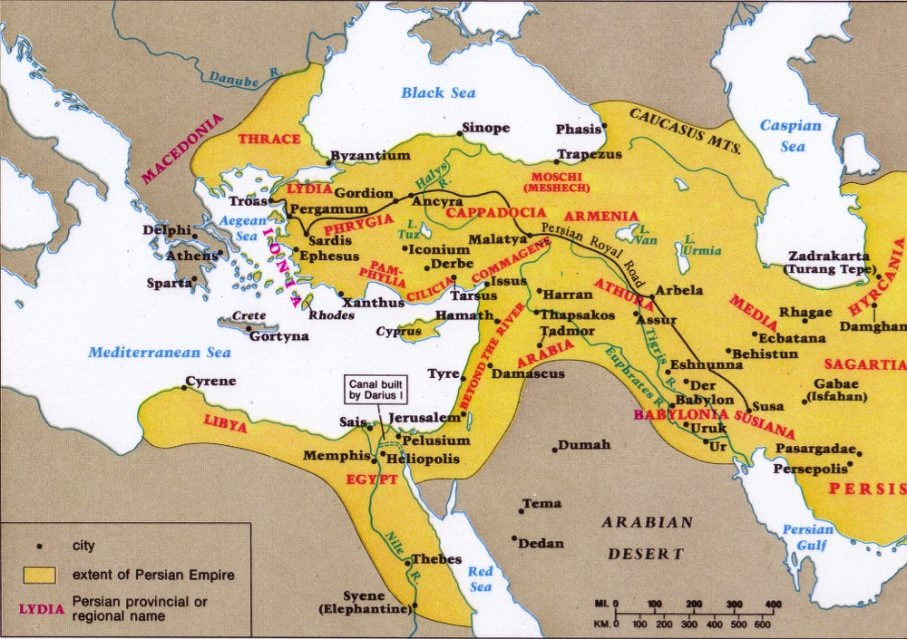
m¾ishdkq jljdkqj
57, 59
wdmiq
j¾Okhka
foaj ud,s.dj
ck;dj
mjqre
Beitzel, Moody Atlas of Bible Lands, 1st ed., 150
Notes:
Daniel predicted that the Medes and Persians would conquer the Babylonians (Dan 2, 7, 8).
• Cyrus the Great was God's instrument prophesied BY NAME over 140 years previously by Isaiah to return the people to Israel (Isa. 44:28–5:2, 13)!
• He started the pattern of three returns to the land under Zerubbabel (temple), • Ezra (people), and • Nehemiah (walls).

Slide 7

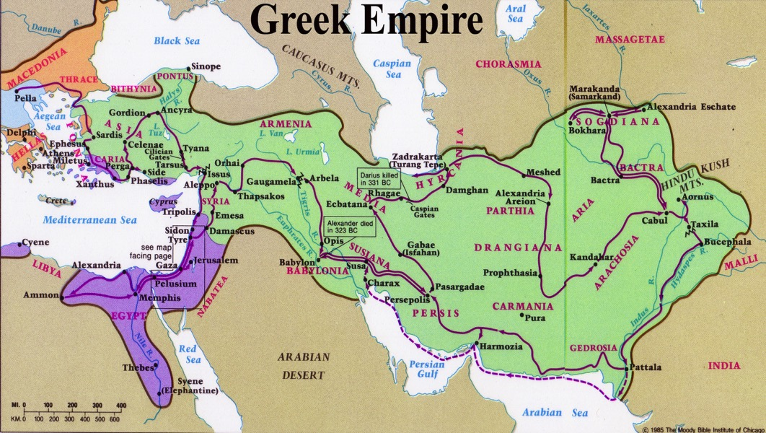
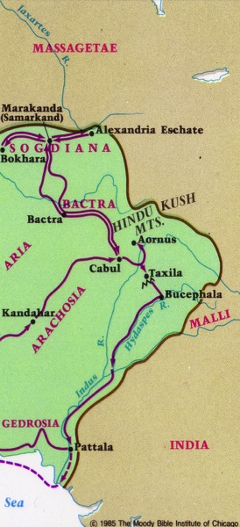


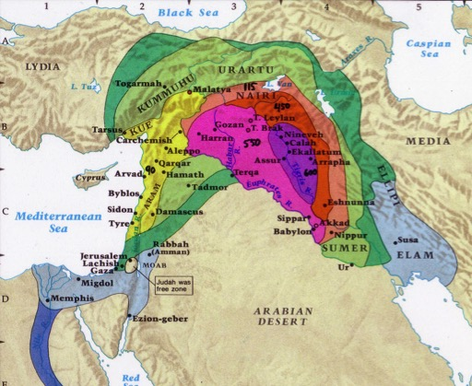
wêrdcHhka ys is;shï - wka;¾ .súiqï ld,h ;=,
52
frdauh
.S%ish
Beitzel, Moody Atlas of Bible Lands, 1st ed., 152

Slide 8
wka;¾ .súiqï ld, rduqj
96
m¾ishdj
539-331
.%Sish
331-143
yiafudakshka
143-63
frdauh
63-330
fmdfgdf,fuhsla323-198
fi,sjqisâ
198-143
ulìhka
167-143
¾
450
400
350
300
2 5 0
2 0 0
150
100
1
wef,laiekav¾
331-323

Slide 9
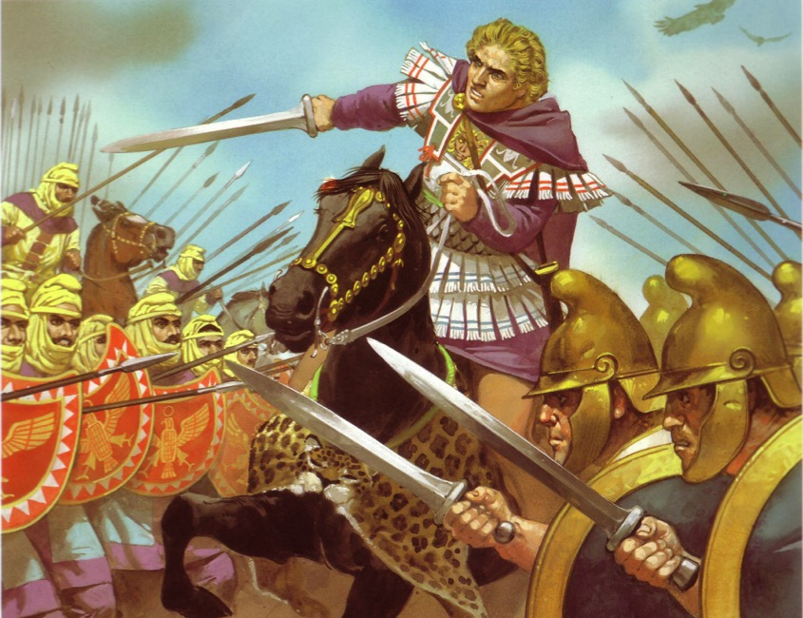
bY%dfh,fha .%Sla md,kfha wjidkh
60
wef,laiekav¾
wêm;Hh ioyd igk
fy,kSh wêrdcHfha j¾Okh

Slide 10
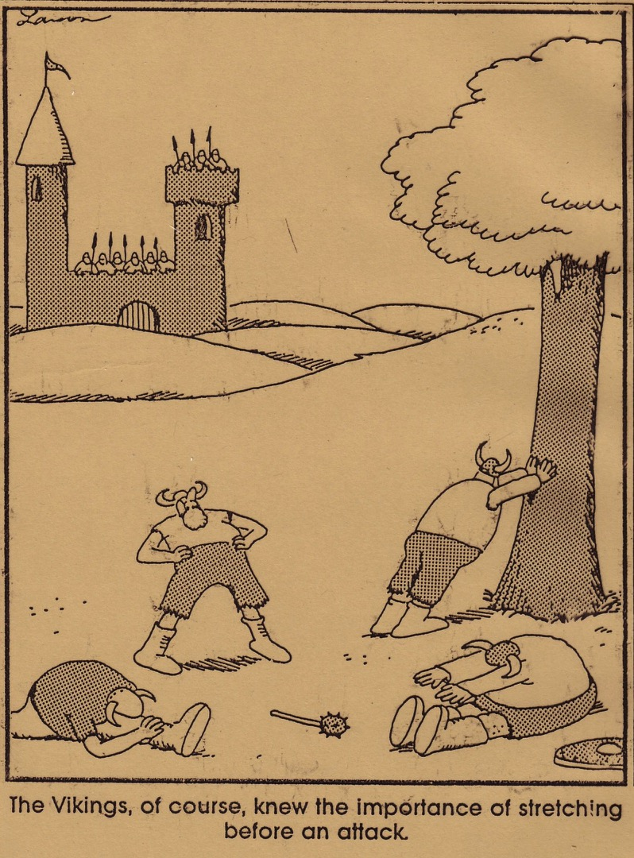
ienúkau jhslsx.aiajre wdl%uKhlg fmr os.eoSu jeo.;alu oek.;a;d' .%Sish o tf,ih'

Slide 11
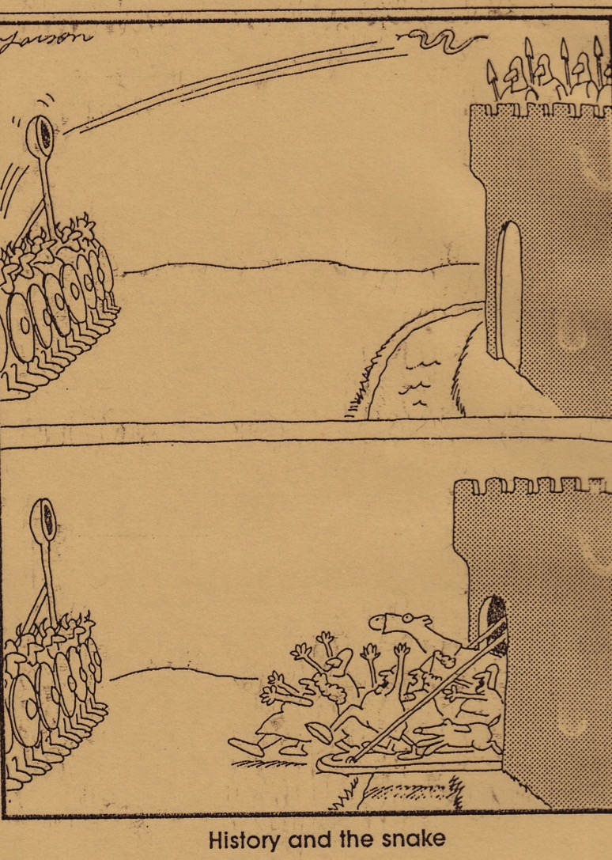
b;sydih iy i¾mhd

Slide 12
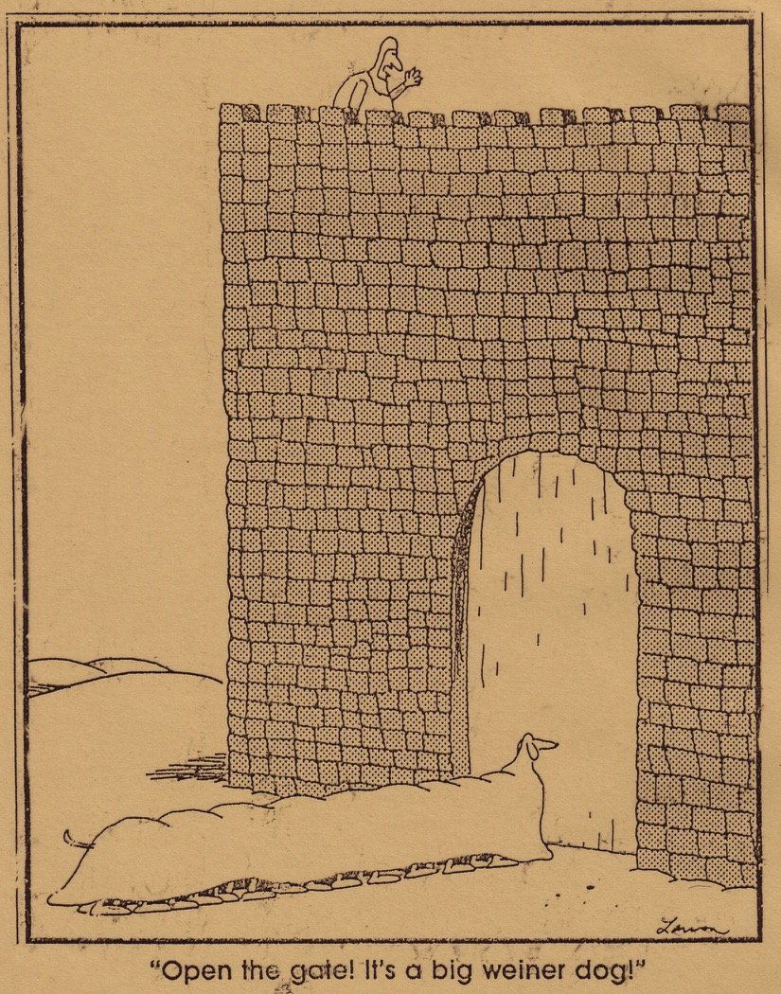
¸ f.aÜgqj wrskakŒ ta f,dl= jhsk¾ n,af,laŒ¶

Slide 13


wef,laiekav¾f.ka miq rdcOdks 4
64
.S%ish
likav¾
,hsisudlia
fi,shqisâ
fgd,ñ
Beitzel, 1st edition, 152

Slide 14
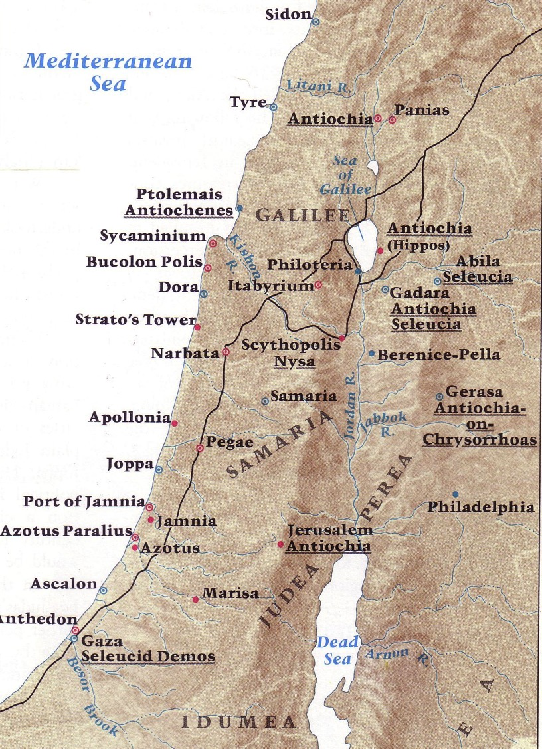
bY%dfh,fha msysá .%Sl k.r
Beitzel, 1st edition, 153

Slide 15
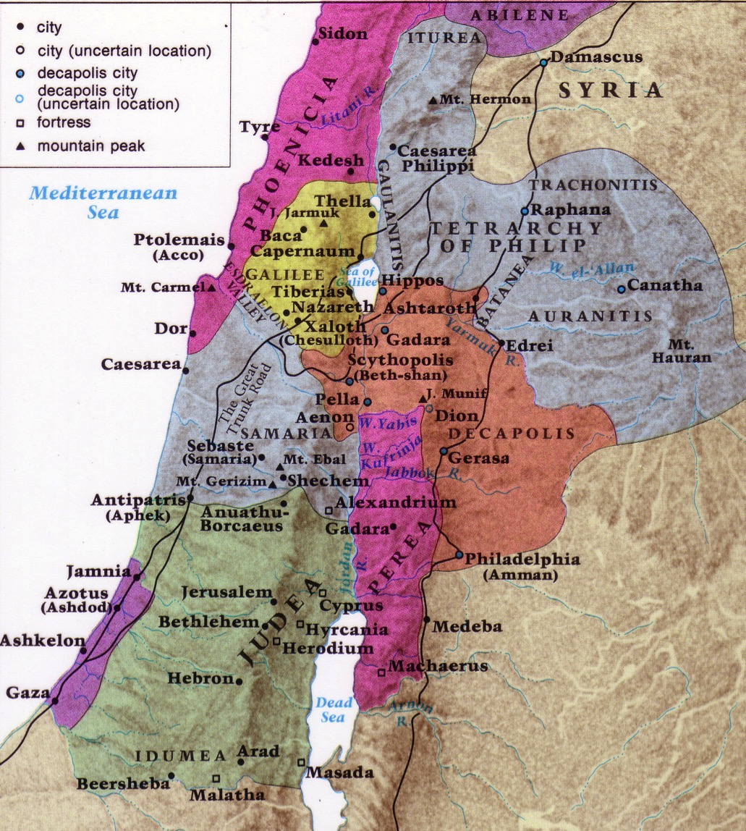
kj .súiqï iufha bYdfh,fha foaY iSudjka
Beitzel,
1st edition, 19

Slide 16
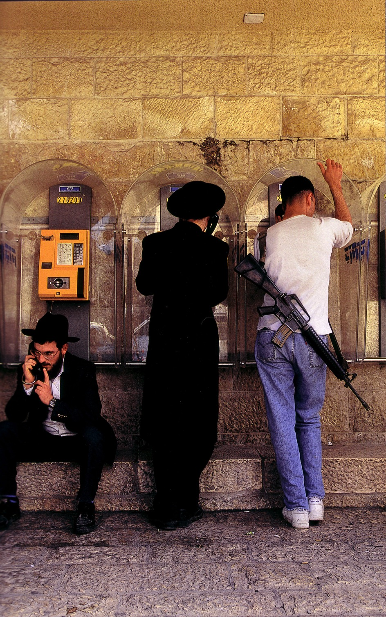
wo ixialD;sl fjki

Slide 17
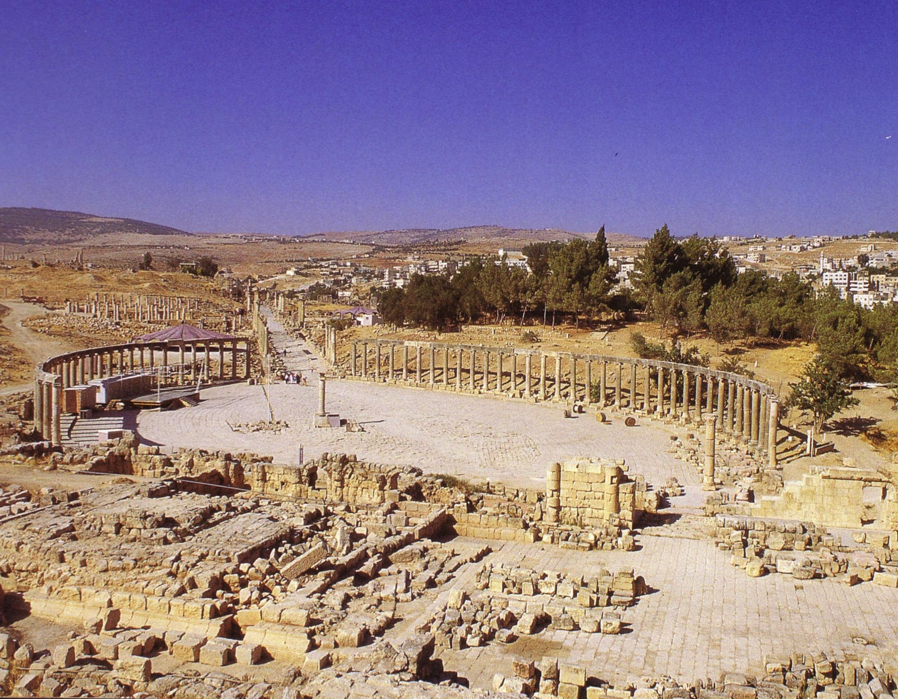
folfmd,sisfha ys fcrdYa

Slide 18
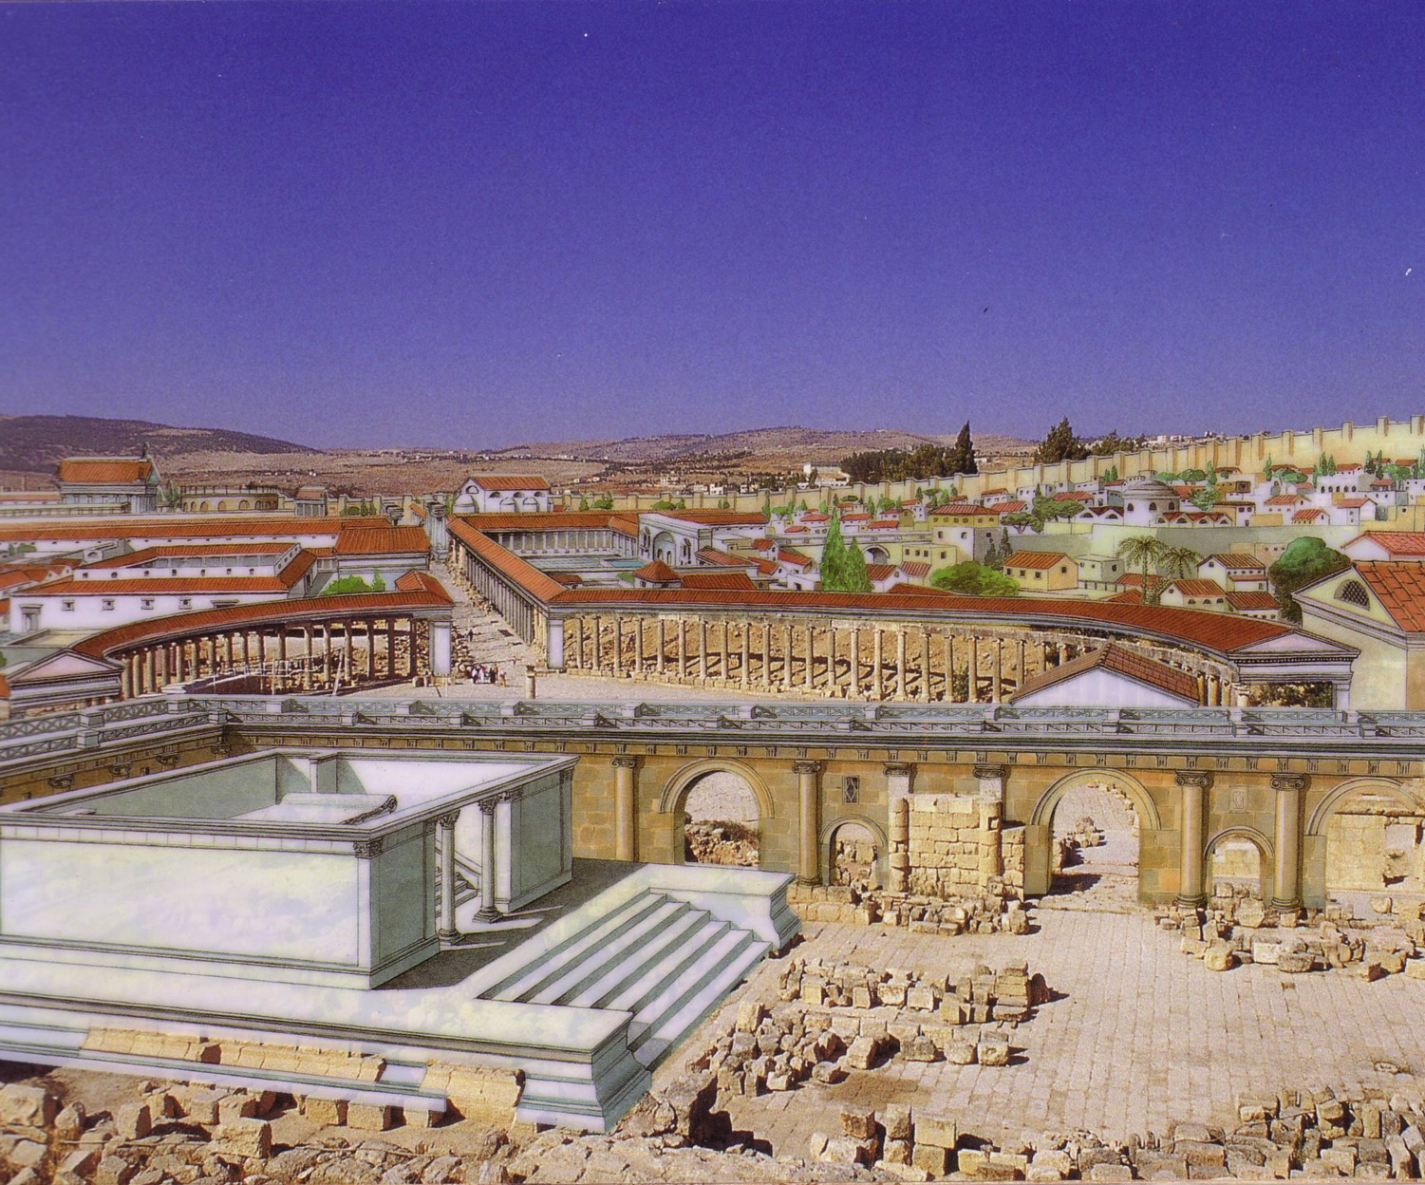
tys .ek fcrdYa ;=, jq lS¾;su;a osk

Slide 19
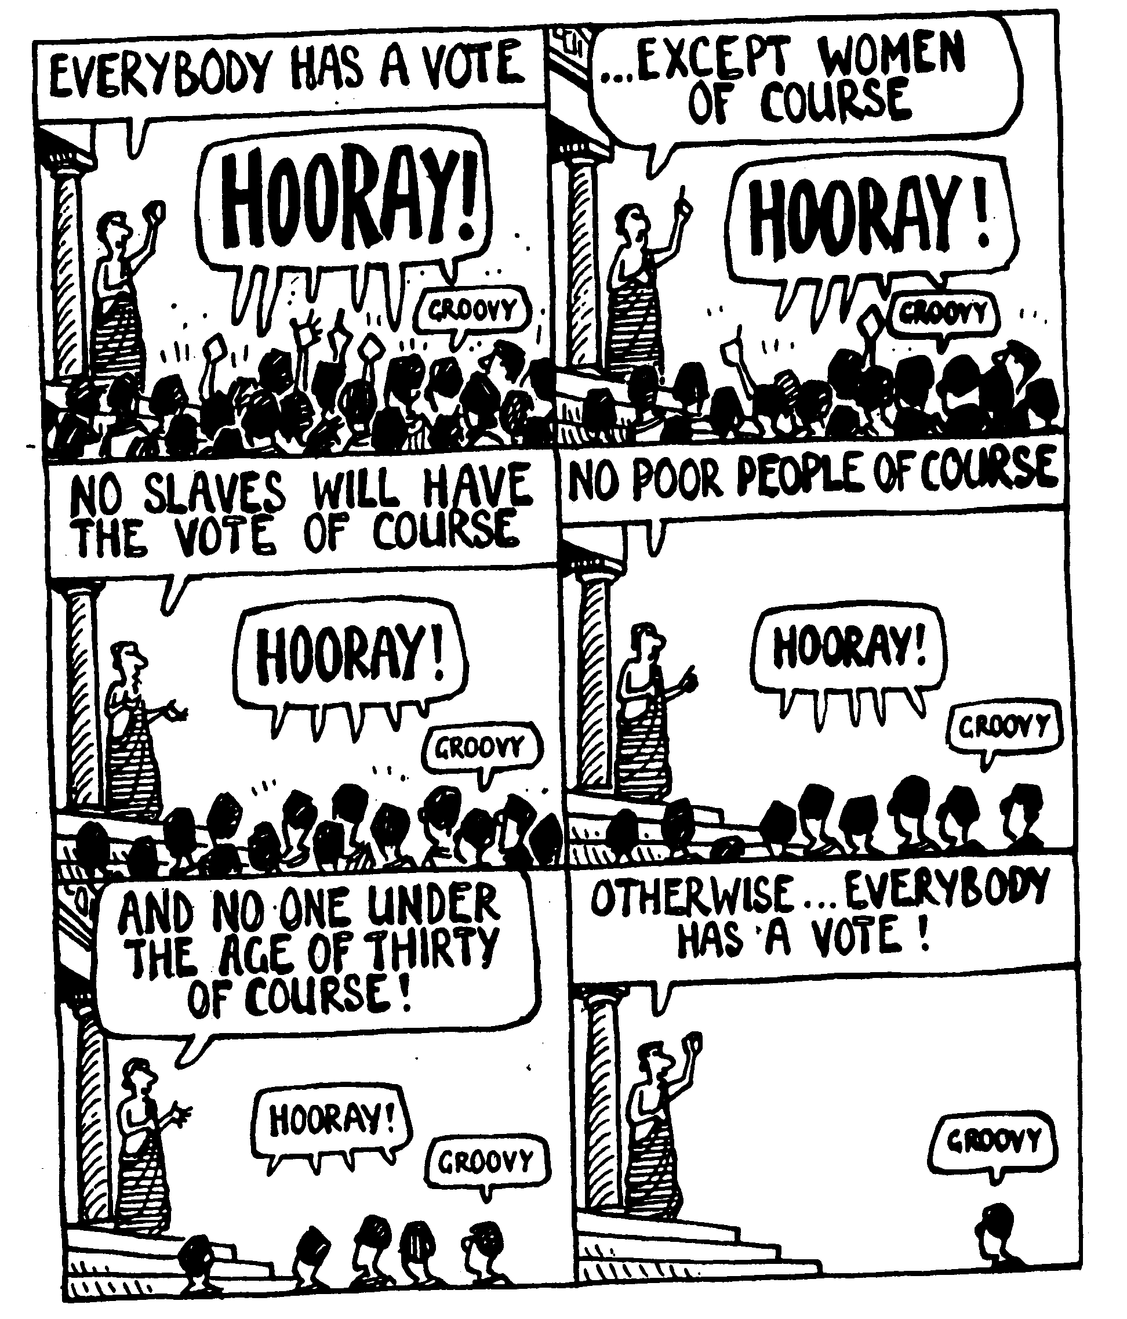
.%Sisfha w;ayodne,Su iu. m%cd;ka;%jdoh

Slide 20
bY%dfh,fha fgd,ñ iy fi,shqisâjrekaf.a md,kfha wjidkh
63
lvqj
iduh
Beitzel, 1st edition, 152
fi,shqisâ
fgd,ñ

Slide 21
.szla hq.fha we;s jeo.;alu
62, 65, 95
fgd,ñ (301-198)
fi,shqisâ (198-143)
wd.ñl ksoyi
iekafykafykaä%ka msìosu
iekafykaä%kays iudodkh
fy,kslrKh
.zSla NdIdj
fimagqjdcska;h
by, mqcl;ajh
yioSkaj/kaf.a ke.sàu

Slide 22
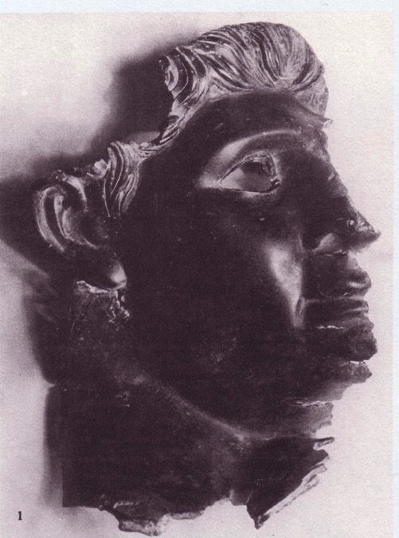

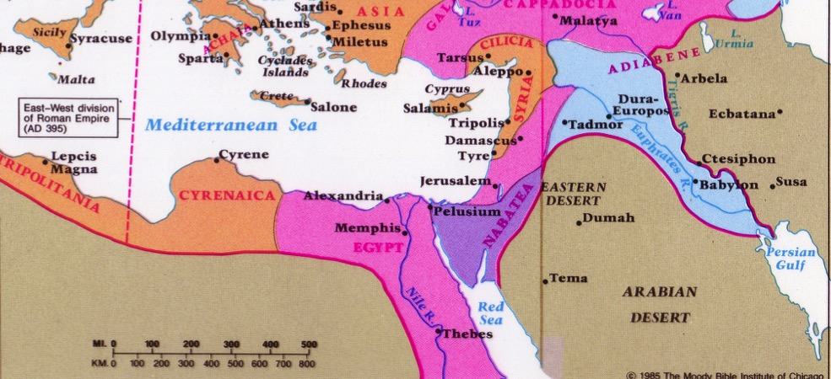
wka;sfhdalia IV
65
odksfh,a 11(29)30 ¸kshu ld,fhaoS Tyq kej; ol=Kq osYdjg tkafkahŠ kquq;a wka;su .uk m<uqfjks .uk fuka fkdjkafkah' ulaksido ls;a;Sï keõ Tyqg úreoaOj tkafkahŠ Tyqo l,lsrS" yerS f.dia" Y=oaO .súiqug úreoaOj fldam ù" ;udf.a leue;a; bIAgfldg" Y=oaO .súiqu w;ayrskakka kej; i,lkjd we;'¶
Beitzel,
1st edition, 166

Slide 23

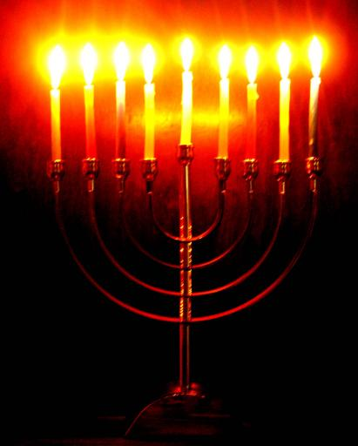

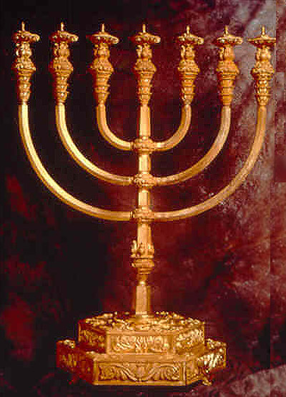
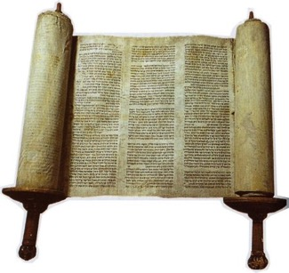
fcrei,u iy fy<kslrKh
65
foie 167- foie 164
ykqld
myk
wdf,dalj;a ux.,Hh
^lemlsrSu&

Slide 24
.S%la hq.fha we;s jeo.;alu
62, 65, 95
fgd,ñ (301-198)
fi,shqisâ (198-143)
wd.ñl ksoyi
iekafykafykaä%ka msìoSu
fy,kSlrKfha iudodkh
.S%la NdIdj
fimagqjdcska;h
by< mqcl;ajh
yioSkajrekaf.a ke.sàu
foajud,s.dj fl,isu
ulìjrekaf.a le/,a,

Slide 25
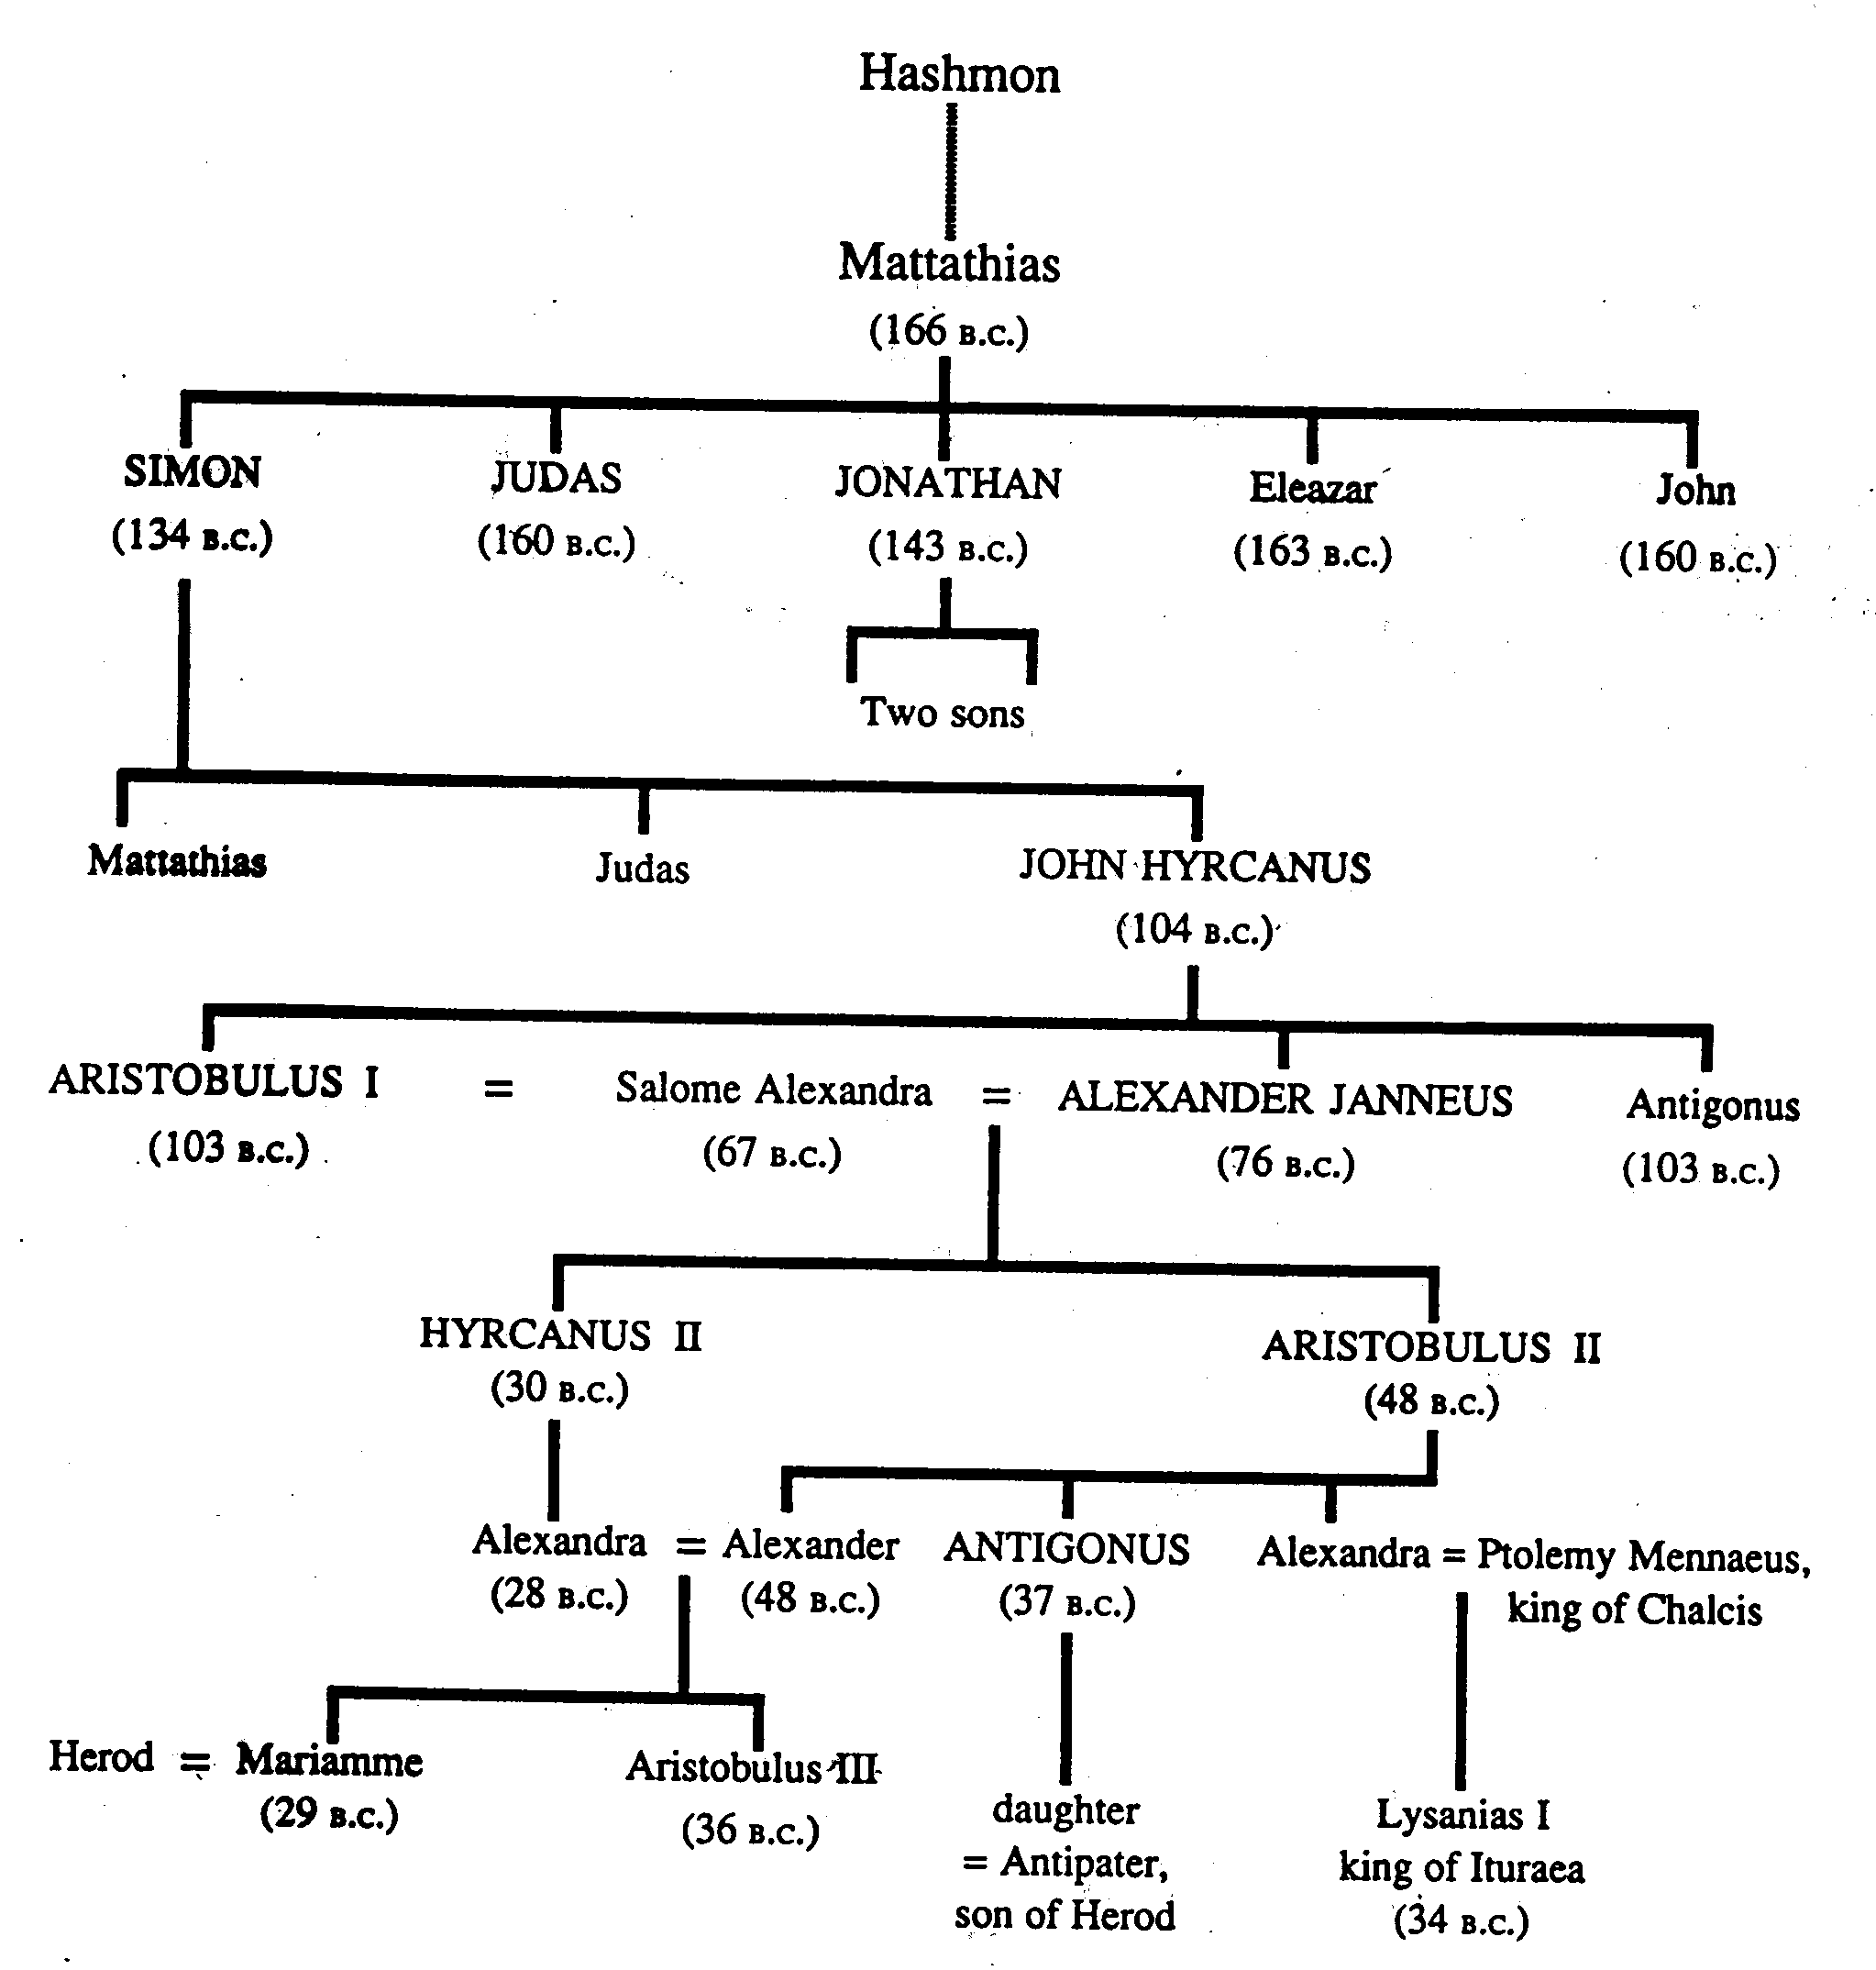
ulìjreka
68
m,ia;skfha hqfoõ md,kfha wjidkh(143-63 BC)

Slide 26
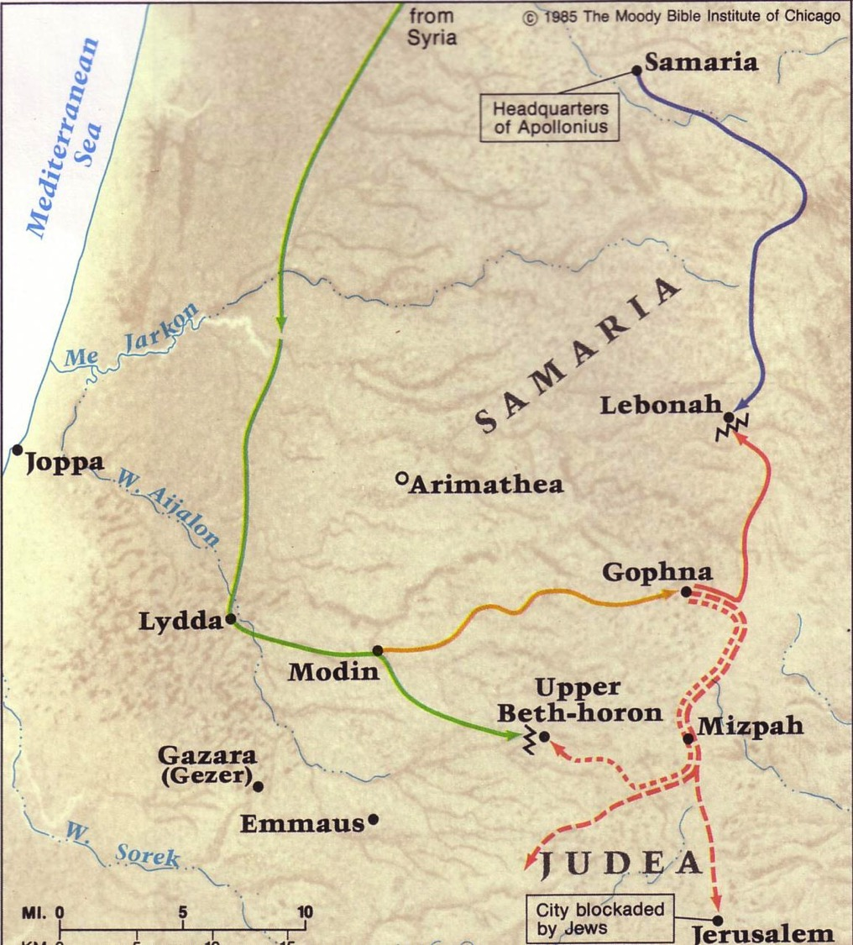
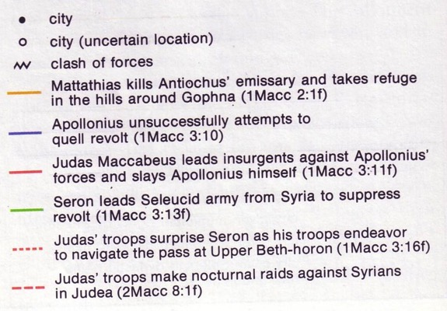
m<uq ulìhdkq le/,a,
66
hqfoõjkaf.a mrdch wfmd,qfkarshia
cqodia úiska isrshkajreka wdl%uKh lsrSu
u;a;shia iy Tyqf.a mq;d lÿlrhg m,d .shd
u;a;shia hqfoõjka iy ks,Odrska urk ,os
cqodia úiska fiarkajre mrdo lsrSu

Slide 27
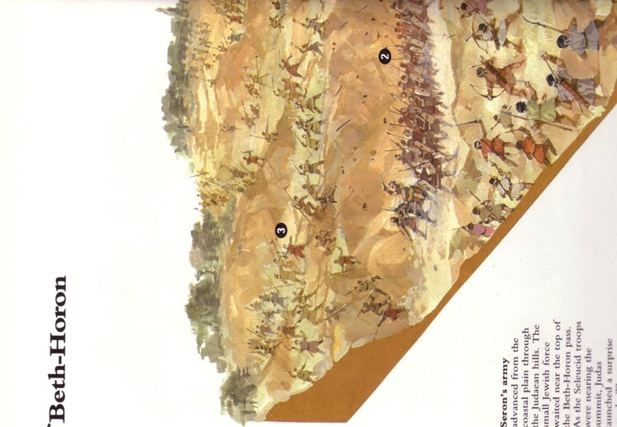
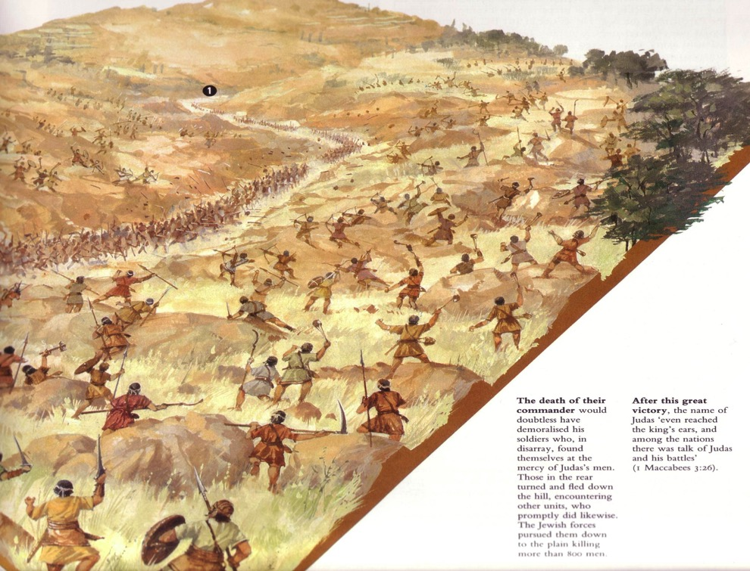
fyfrdkays hqoaOh
ulì lere,af,a wdrïNh

Slide 28
.S%la hq.fha we;s jeo.;alu
62, 65, 95
mafgdfuhsla (301-198)
fi,shqisâ (198-143)
wd.ñl ksoyi
iekafykavszkays ke.sgsu
fy,kSlrKfha iudodkh
.%Sla NdIdj
fimagqjdcska;h
by< mqcl;ajh
yioSkajrekaf.a ke.sàu
foajud,s.dj fl,iSu
ulìjrekaf.a le/,a,
iÿisjrekaf.a ke.sàu

Slide 29
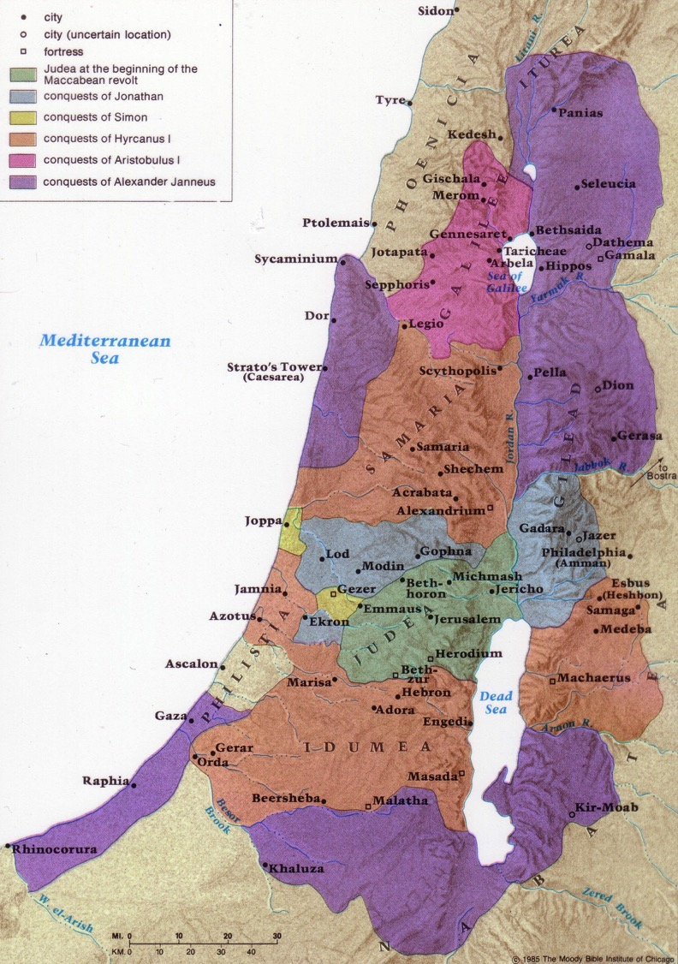
yiafudkshïjrekaf.a me;srSu
69
Beitzel, 1st edition, 155

Slide 30
yiafudakshïjrekaf.a jeo.;alu
66-67, 95
foaY iSud jHdma;sh
frdaujreka iu. ikaOdkh
hqfoõ n,mEu
fcdaka yhsldkia

Slide 31
yiafudakshïjrekaf.a me;srSu
69
?
?
Beitzel, 1st edition, 155

Slide 32
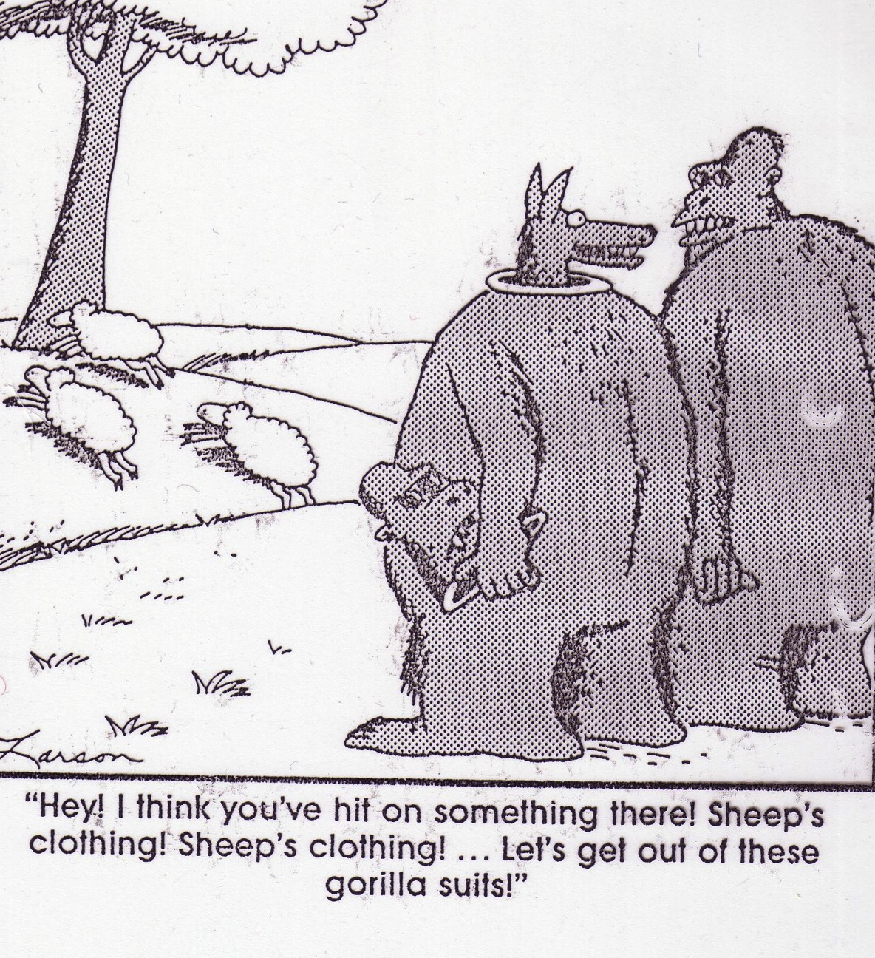
“uu ys;kjd Thdg neg,q weoqfuka .syska myr fokak hula t;k ;sfhkjd lsh,d wms fï f.dars,a,d we∫u bj;a lr,d huq”

Slide 33
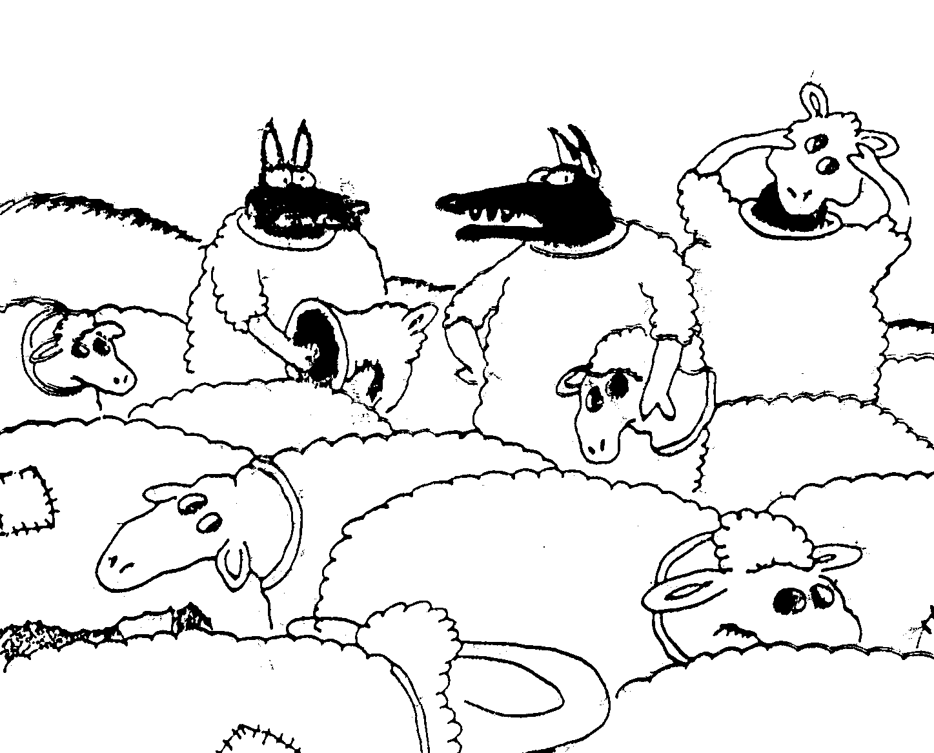
“;;amrhla kj;skak! kshu neg,qfjla fuys keoao?”

Slide 34
yiafudkshïjrekaf.a n,mEu
66-67, 95
wd.ñl ksoyi ) mrsisjreka
ykqld ^wdf,dalj;a ux.,Hh&
^cqodia yd ioqisjre&
mQclhd iy rc;=ud ^fcdk;dka&
Tikaiajrekaf.a ke.sàu ^ihsuka&
foaY iSud jHdma;sh
frdaujreka iu. ikaOdkh
hqfoõ n,mEu
fcdaka yhsldkia

Slide 35

frdau le/,a,(50 BC-AD 100)
94c
frdauh

Slide 36
fï hq.hka .ek Tn oeka okakjdo@
fy,kSh
folfmd,sia
mQrSï
iudrs;hka
fimagqjdcska;h

Slide 37


නව ගිවිසුම් පසුබිම සදහා ලින්ක්: BibleStudyDownloads.org
මෙම ඉදිරිපත් කිරීම නොමිලයේ ලබා ගන්න!
Notes:
NT Backgrounds (nb)

Slide 38
Black

